Slide 1
2016 City of Tacoma Right-of-Way Design Manual
Training December 2015 / January 2016

Slide 2
Chapter 1 – Introductions and General Requirements
Effective January 7, 2016
This manual applies to construction of all street and ROW improvements including stormwater, wastewater, street lighting, traffic signalization, landscaping, ADA, and channelization.
Designed to be used in conjunction with other local, state, and federal rules, regulations, and design standards.
WSDOT Standard Plans
City of Tacoma Standard Plans
City of Tacoma General Special Provisions (GSPs)
Notes:
Merita

Slide 3
Questions…

Slide 4
Chapter 8 – Pedestrian Facilities
This is a new chapter that incorporates ROW elements that affect accessibility
The City strives to make the ROW useable for everyone
Includes elements such as sidewalks, curb ramps, accessible pedestrian signals, crosswalks, and maintaining pedestrian access during construction
Notes:
Gail

Slide 5
Chapter 8 - Pedestrian Facilities
ADA Requirements by Project Type:
New construction- full ADA compliance with no excuses
Alterations- full ADA compliance but if infeasible a detailed written justification is required
Maintenance- does not trigger ADA upgrades

Slide 6
Chapter 8 - Pedestrian Facilities
Accessibility Criteria for Pedestrian Circulation Paths and Access Routes
Pedestrian Circulation Paths (PCPs)
Vertical clearances, horizontal encroachments, post-mounted objects
Pedestrian Access Route (PAR)
Clear widths, cross slope and grade, surface, horizontal openings

Slide 7
Chapter 8 - Pedestrian Facilities
Curb Ramps
Types of curb ramps
Accessibility criteria
Design Criteria
Directional curb ramps
Drainage
Design to less than the maximum slope

Slide 8
Chapter 8 - Pedestrian Facilities
Accessible Pedestrian Signals (APS)
Location
Function
On-Street Parking
ADA/disability parking
At-Grade Rail Crossings
Mind the gap

Slide 9
Questions…

Slide 10
Chapter 2 – Right-of-Way/Site Permitting and Local Improvement Districts
Updated Chapter to reflect new permitting process:
New permit types: ROW Construction and Site Development Permit
Work Orders will continue to be issued in conjunction with the ROW Construction Permit
Site Development Permit will be for onsite development, grading, paving, new impervious, etc.
Notes:
Stephanie
New Permits: ROW Construction – for all work within the right of way.
Site Development Permit – Minor or Major depending on thresholds/scope of project/size.
Combined Permits: Goal is to have one combine civil plan set for all work as part of development. Hopefully this will prevent design issues/conflicts that are a result of multiple plan sets. One change affects multiple drawings, ect.
New software: New permitting software is being set up for the new Site Development Permit, ROW Construction permit to be combined and essentially tied together for review.

Slide 11
Chapter 2 – Right-of-Way/Site Permitting and Local Improvement Districts
New process continued:
For project sites with both onsite and offsite work proposed as part of development, plans may be submitted covering both as a joint Site Development Permit with an attached ROW Construction Permit or Work Order Permit
Intended to speed up approval process by allowing one plan set for entire development, and avoid potential conflict points between plan sets.
Transition will occur as part of the new permitting software, Accela. Projected for Late January 2016.
Notes:
Stephanie

Slide 12
Chapter 3 – Site Development Permit and Right-of-Way Construction Plan Format
Updated chapter to reflect new permit naming:
No major changes
Updated references to new permits
For combined onsite and offsite plan sets, requires the use of City border template.
Discussion of differences between capital delivery projects, and private development projects.
Notes:
Stephanie
No major changes, updating to correct new references.
Currently every City Department uses a difference plan format. Discussions have begun on a possible universal plan format for all departments.

Slide 13
Questions…

Slide 14
Chapter 4 – Street Design
Updated the geometric design references and cross-sections
Street Typologies introduced
Clarified information about access to/from the street system
Mobility (pedestrian) facilities updated
Traffic calming guidance
Incorporated Green Stormwater Infrastructure
Notes:
Raymond goes through this quickly as the overall intro since next slide (Geometric Design) is his to discuss?

Slide 15
Chapter 4 – Street Design Geometric Design
Updated references to design guidelines documents and policies
Clarified ambiguities
Continued reliance on AASHTO Policy (“Green Book”)
Revised information on straight grades and grade breaks
Provides details about roadway cross-sections
Notes:
Raymond
Clarity for Lane Configurations: incorporation of configurations including bike lanes and references to other bike facilities
Pavement design: now includes guidance for more sustainable/green design options
Transition to next slide…”also added were new illustrations, such as…” <next slide>

Slide 16
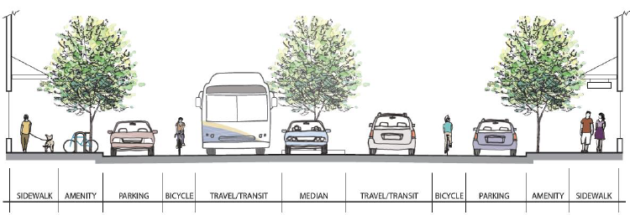
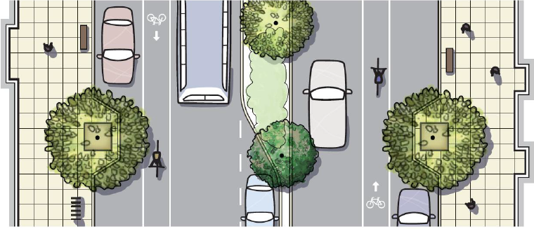
Chapter 4 – Street Design Geometric Design
Notes:
Raymond
Transition to Brennan

Slide 17
Chapter 4 – Street Design Overview Comparison
2016 Sections/Topics
2004 Sections/Topics
Street Typologies
Basis for Geometric Design
Geometric Design
Roadway Intersections
Street Section
Access (includes Dead Ends, et. al)
Mobility Facilities
Monumentation
Street Amenities & Additional Design Features
Not in previous
same topic
same topic
Intersections
same topic
Access
Dead Ends
Pedestrian Facilities
same topic
Additional Street Design Considerations

Slide 18
Street Typologies
Identifying Street Classification and/or Street Type
References pertinent resources (Comp Plan/TMP, arterials, speed limits, transit routes, pedestrian streets, adopted design guidelines)
Design Guidelines & Resources
Citywide Design Guidance
(e.g., Green Roads Community Policy & Program, Comp. Plan/TMP, Ped & Bike Guidelines)
Area Specific Design Guidelines
(e.g., Complete Streets Residential Design Guidelines, CS Mixed-Use Centers Design Guidelines, CP-Downtown Element, specific subarea and corridor plans/guidelines)
Green Stormwater Infrastructure

Slide 19
Chapter 4 Section 1.3 Green Stormwater Infrastructure
Green Stormwater Infrastructure (GSI) is a set of distributed stormwater BMPs that seek to mimic natural systems and deliver multiple community benefits in addition to stormwater management.
Low Impact Development (LID) BMPs are part of GSI.
SWMM must be followed for requirements and BMP design.
Certain design criteria, construction and material requirements found in Design Manual.

Slide 20
Chapter 4 Section 1.3 Green Stormwater Infrastructure
Permeable Pavement
SWMM BMP L633
Standard Details – in development
Subgrade Preparation Section 5.4.1
Permeable Ballast Base Course Section 5.5.1
Section Design per Std. Plan PD-01 and PD-02
In Progress - Wearing Surfaces
www.cityoftacoma.org/permeablepavement
Bioretention
SWMM BMP L630
Standard Details – in development
Notes:
Jessica
…
Would then make sense to transition to Chapter 5 – Stormwater

Slide 21
Preferred Green Stormwater Infrastructure Guide
Watershed
Arterial
Is treatment required?
Yes
No
Collect & Convey
Bioretention*
Residential
Is treatment required?
Yes
Pervious Pavement*
No
Marine
Freshwater
Arterial
Is treatment required?
Yes
Bioretention*
No
Collect & Convey
Residential
Pervious Pavement*
Collect & Convey

Slide 22
Access Overall Comparison
Access Section
2016 Design Manual
Access & Dead Ends Sections
2004 Design Manual
Subsections of:
Functional Classification & Connectivity
Access Management
Access Location & Spacing
Medians
Driveways
Private Access-ways
Requirements for Plats/Short Plats
Alleys
Dead Ends
Turn-arounds
Cul-de-sacs
Subsections of:
Driveways
Private Access Ways
Alleys
Dead Ends
Turn-arounds
Cul-de-sacs
Barricades
Notes:
Referral to TMC 11.05 for defining roadway classifications in preparation for access spacing requirements (from TMC 10.14.050.A.11) later in section
“New developments shall provide new roadways and connections which support interconnectivity including pedestrian accessibility to bus stops and non-motorized routes”
Specific changes (per SDG) with “Design Requirements for Developments” 3 to 4 lots: 32 ft for 24 ft (compared with 30 for 24); 2 lots: 27 for 16+4 vs 20 for 16+4; “Sidewalk and pedestrian pathways” criterion: “required along all lot frontages” (all lot number scenarios); Street Trees criterion, Street Edge Improvements criterion
Dead Ends/Turn-arounds: “Any dead end street in excess of 150 feet in length shall terminate in a turn-around or cul-de-sac (see Sections 6.10 and 6.11 below).” & “Regardless of length, all public dead end streets shall provide a turn-around to the approval of the City Engineer.”

Slide 23
Access Management
The following information will be used to evaluate access and should be consulted prior to street design:
The Citywide Design Guidance Documents (Section 1.2.1) and Area-Specific Design Guidelines (Sections 1.2.2), zoning, and land development regulations as set forth in adopted City comprehensive plans.
The current functional classification of the roadway (or potential classification in the case of a new roadway).
Existing and projected traffic volumes, crash history, non-motorized volumes, and other operational considerations.
Existing and projected state, local, and regional planning organization transportation plans and needs, including considerations of new or improved facilities.
“New driveways shall be located from an alley or court when suitable access is available, such as an abutting ROW that is or can practicably be developed.”

Slide 24
Access Management (cont’d)
The following information will be used to evaluate access and should be consulted prior to street design:
Drainage requirements and utilities.
The physical features of land adjoining the roadway.
The type and volume of traffic requiring access.
The availability of alternative or shared connections to the existing roadway network.
The cumulative effect of existing and projected connections on the roadway’s ability to provide safe and efficient movement of people and goods.
“New driveways shall be located from an alley or court when suitable access is available, such as an abutting ROW that is or can practicably be developed.”
Notes:
Pre-existing access conditions will have some bearing on the approval process, but the new access control/spacing requirements will be more stringent

Slide 25
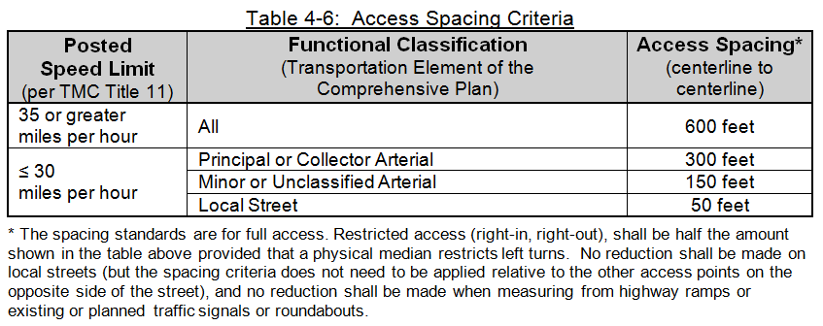
Access Location & Spacing
“New access points shall be placed outside the functional area of nearby intersections and other existing access points. The following criteria shall be used for determining the minimum spacing between access points, unless special authorization is given by the City Engineer.”
Notes:
Meet the table requirements for full access and likely minimal additional conditions
Restricted access (right-in/out) can be permitted at half the values (conditions will apply)
No spacing reductions related to highway ramps, existing/planned signals or roundabouts

Slide 26
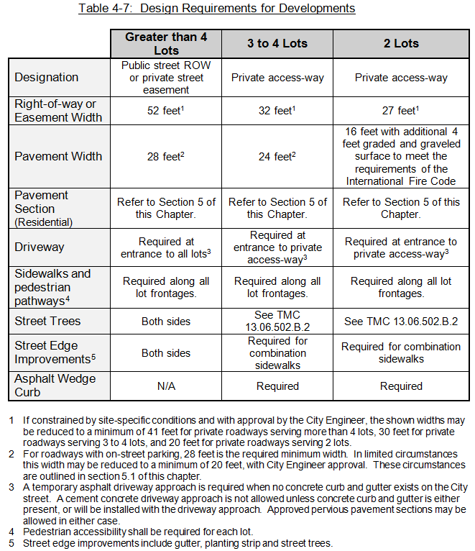
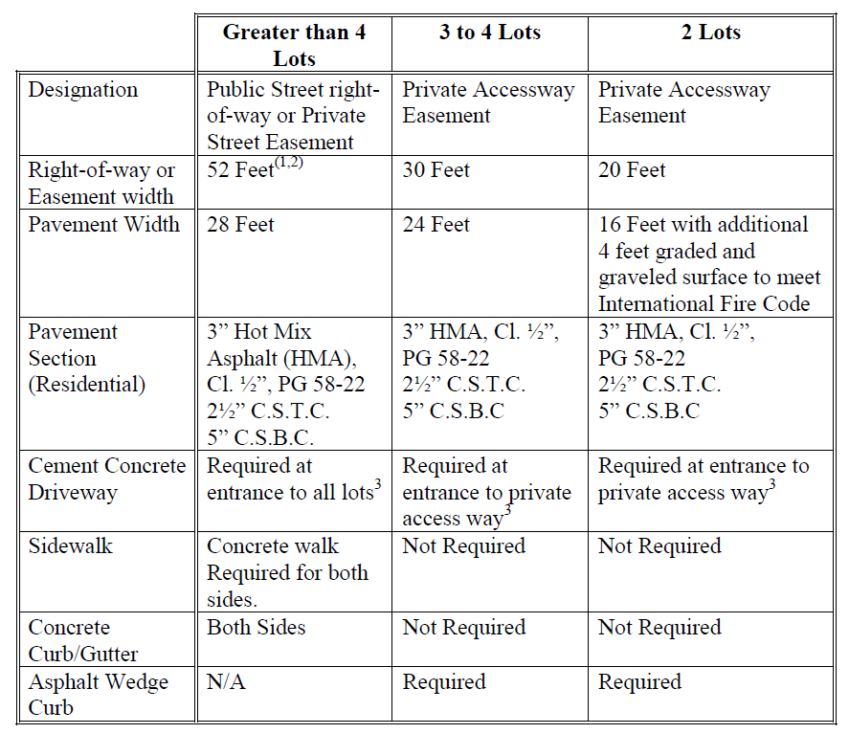
Access Private Access-ways Comparison
2016 Design Manual (Ch. 4, 6.6)
2004 Design Manual (Ch 1, 1.030.F)

Slide 27
Access Dead-Ends / Turn-arounds
“Dead end roadways shall not be allowed without approval of the City Traffic Engineer.”
“In cases when it is not feasible to connect roadways, but feasible to establish a non-motorized pathway, then the pathway shall be constructed.”
“In general, dead end streets shall not be longer than 500 feet. Any dead end street in excess of 150 feet in length shall terminate in a turn-around or cul-de-sac (see Sections 6.10 and 6.11).”
“As stated in the International Fire Code, a turn-around meeting the design requirements discussed within this section, shall be designed and constructed for all dead end private access-ways over 150 feet in length. Regardless of length, all public dead end streets shall provide a turn-around to the approval of the City Engineer.”
“Cul-de-sacs shall be constructed where a dead end street will serve 5 or more residential lots.”

Slide 28
Mobility Facilities Sidewalk, Amenity Zone and Buffer Widths
Arterials
Adjacent to arterials, sidewalk widths shall be a minimum of 7 feet (excluding the curb and buffer or planting strip), unless otherwise specified in the TMC or City design guidelines.
Wider sidewalks may also be required adjacent to angle parking to account for vehicle overhang.

Slide 29
Mobility Facilities Sidewalk, Amenity Zone and Buffer Widths
Mixed Use Centers
City Council has directed that wider sidewalk and amenity zones be provided (see Complete Streets Mixed-Use Centers Design Guidelines)
Fully improved sidewalks or when a minimum half-block length (or 100 foot on longer frontages):
Designated as primary pedestrian or pedestrian streets in TMC 13.06 and 13.06A, a typical sidewalk width of 10 to 12 feet and an additional amenity zone width of 6 to 8 feet shall be provided
With the approval of the City Engineer, this combined total width of the sidewalk and amenity zone may be reduced to a minimum of 12 feet (excluding the curb) in order to accommodate a safety issue or unique site constraints
Reductions should be avoided if feasible on primary pedestrian streets.

Slide 30
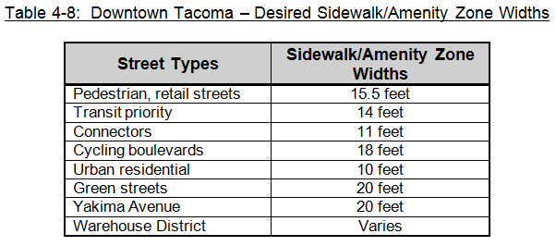
Mobility Facilities Sidewalk, Amenity Zone and Buffer Widths
Downtown
Specific sidewalk and amenity zone widths are called out by street in the Downtown Element of the Comprehensive Plan
In all circumstances, a minimum 7 feet shall be provided for unobstructed pedestrian passage.

Slide 31
Mobility Facilities Curb Ramps and Crosswalks
ADA and PROWAG requirements are discussed in Chapter 8 Pedestrian Facilities of the Design Manual.
A legal crosswalk exists at every intersection, unless it is otherwise signed. However, marked crosswalks encourage pedestrians to cross at designated locations.
The Engineering Division of the Public Works Department must approve all new marked crosswalks (see Chapter 7 for more information).
Notes:
Additional points:
All curb ramps shall be designed and constructed to be ADA-compliant in accordance with City Standard Plans and Public Right-Of-Way Accessibility Guidelines (PROWAG).
The City’s Curb Ramp Installation Matrix should also be consulted to identify the extent of curb ramp improvements related to ROW improvements.

Slide 32
Mobility Facilities Traffic Calming & Intersection Treatments
The Design Manual provides guidance for considering a traffic calming approach for any street (also see Table 4-9, next slide).
Some of the criteria to be considered:
Traffic conditions, multi-modal provisions
Neighborhood involvement
User expectation, meeting multiple objectives
Accommodation of emergency vehicles
Effective, maintainable
Treatments may include or be provided in conjunction with Low Impact Development stormwater features
Notes:
Multiple goals: For example a raised crosswalk may be more understandable to motorists than a speed hump. The former has a clear goal whereas the latter may be perceived as a nuisance.
Well-designed: Information on U.S. experiences with various traffic calming measures can be found in Institute of Transportation Engineers’ (ITE) Traffic Calming: State of the Practice.
Spacing: Devices usually need to be spaced about 300 to 500 feet apart. If they are spaced too far apart, motorists may speed up between them.
Treatments may include or be provided in conjunction with Low Impact Development stormwater features

Slide 33
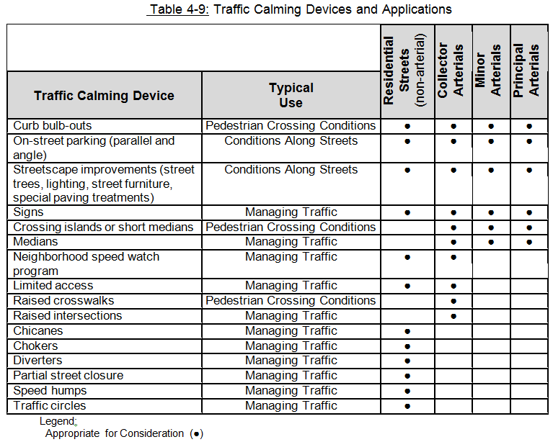
Mobility Facilities Traffic Calming & Intersection Treatments (cont’d)
Notes:
“Guidance at a glance” starting point

Slide 34
Monumentation Section No Changes

Slide 35
Street Amenities & Add’l Design Features Amenity Zone
“The amenity zone and sidewalk zone often complement one another and should be thought of as a system within a Complete Street.”
“Amenity zones may vary in width depending on available ROW. However a minimum width of 4 feet will minimize encroachment into the sidewalk zone when accommodating features such as street furniture, lighting and tree pits.”
Notes:
“system”…as we’ll see in the next slide

Slide 36
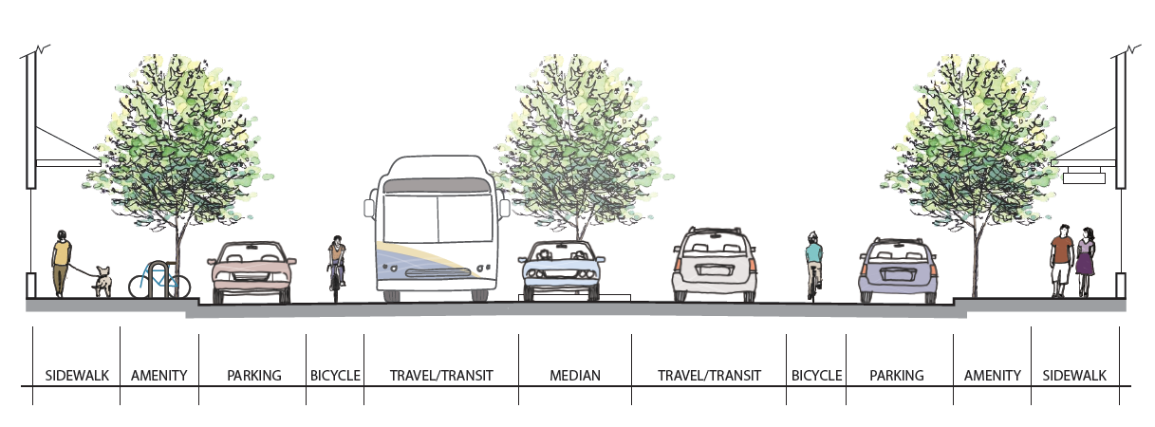
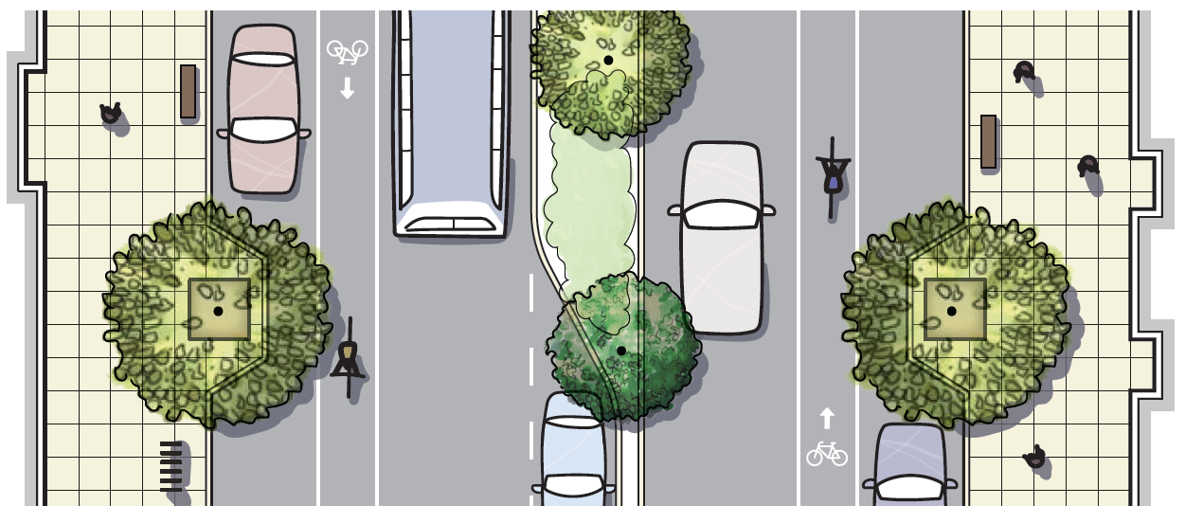
Street Amenities & Add’l Design Features Amenity Zone
Example functions of the shown Street Zones:
Sidewalk : pedestrian movement, business interface, sidewalk cafes (width permitting), signage, planters
Amenity : street furnishings, street trees, utilities, low-impact design (LID) features, clear zone for parking, bicycle parking, bus stop/features, traffic signs.
Parking : on-street parking, bulb-outs, landscape islands, bus lane, on-street bicycle parking
Bicycle : bicycle traffic
Travel/Transit : vehicle movement, including streetcar
Median: turn movements (or restrictions thereof), trees/LID features, pedestrian refuge, aesthetics
Example character elements of the Street Zones:
Sidewalk : unobstructed path for 2 to 3 pedestrians abreast, distinctive paving (as allowable)
Amenity : hard surface except when LID is utilized, pervious pavers or tree grates
Parking : extension of travel/transit zone
Bicycle : visible pavement markings indicating separate or shared lane use for bicycles
Travel/Transit: minimized width while still accommodating larger vehicles such as emergency, freight, and transit
Median: landscaped or hard surface where needed to accommodate clear zone for emergency vehicles
Amenity (functions) : street furnishings, street trees, utilities, low-impact design (LID) features, clear zone for parking, bicycle parking, bus stop/features, traffic signs.
Amenity (character) : hard surface except when LID is utilized, pervious pavers or tree grates
Figure 4-14

Slide 37
Street Amenities & Add’l Design Features Walls
“Where a public wall supports fill material from entering onto the ROW, the wall shall be placed no closer than 2 feet from the back of the sidewalk or future sidewalk.”
“Under no circumstances shall a rock wall be constructed to support a surcharge from the adjacent area or improvements.
Where the wall will not be affected by a surcharge, a rock wall may be constructed up to a height of 4 feet (as measured from its footing to the tallest portion of the wall) without the need for a permit or requirement to submit a design for City review and approval.
Rock walls over 4 feet in height shall be designed by a professional licensed by the State of Washington to perform the associated work.”
“Private walls shall be located a minimum of 2 feet back from the ROW. A Street Occupancy Permit will be required for any private walls approved to be located within the ROW. A Building Permit may also be required for a private wall within the ROW.”

Slide 38
Questions…

Slide 39
Chapter 5 – Illumination
Overview
Developers must provide engineered lighting design
Street lighting used to be designed entirely in-house
Public Works streetlights are part of permit (Chapter 2)
Photometric and electrical construction plans
Standardizes design approach and equipment in-line with current City practices
Secure, tamper-resistant infrastructure
LEDs

Slide 40
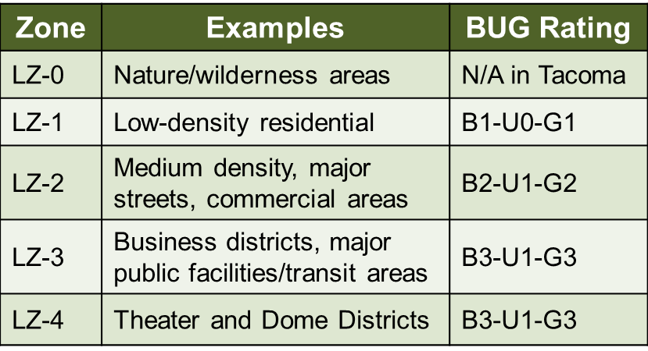
Chapter 5 – Illumination
Design Assumptions
Coordinate with Traffic Engineering as early as possible in the design
Select a lighting zone based on project location and type:

Slide 41
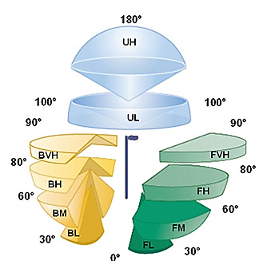
Chapter 5 – Illumination
Design Assumptions cont. – BUG rating
Lighting zones inform the BUG rating of any fixtures
Backlight – Uplight – Glare

Slide 42
Chapter 5 – Illumination
Design Assumptions cont. – Photometric Design
Choose a standard
IESNA RP-8 or AASHTO Roadway Lighting
Choose a calculator (AGi32 is recommended)
Select the parameters
Roadway and Pedestrian Area Classifications
Pavement Type (R1, R2, R3, R4)
Lighting intensity (luminance/illuminance) and uniformity

Slide 43
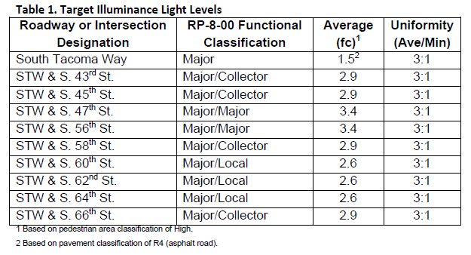
Chapter 5 – Illumination
Design Assumptions cont. – Photometric Design
Specify fixtures, locations, and mounting heights

Slide 44
Chapter 5 – Illumination
Design Assumptions cont. – Light Standards
Overhead lighting with LED cobraheads is default
30- or 40-foot metal typical – flush handhole
Post-top lighting may be required based on context
Downtown and mixed-use centers
Business districts
Residential, historic plats, etc.
13-foot exposed-aggregate concrete with Holophane® GranVille® II LED

Slide 45
Chapter 5 – Illumination
Design Assumptions cont. – Cobrahead Fixtures
Approved List:
Beta/Cree, Leotek®, General Electric, AEL/Holophane
Specs:
Tool-less entry, NEMA 7-pin LED-compatible photocell receptacle, time delay fuse (in-head)
CCT: 4000-5300 K
Minimum CRI: 70
Approved BUG ratings

Slide 46
Chapter 5 – Illumination
Construction Plans/Electrical Design
1¼-inch PVC (SCH 80 under streets/driveways)
WSDOT Type 1 junction box with locking lid
Provide voltage drop calculations for each circuit
#6-#8 gauge typical
Maximum 20 light standards per circuit unless otherwise approved
Read Tacoma GSPs

Slide 47
Questions…

Slide 48
Chapter 6 – Traffic Signalization
Overview
Developers must provide engineered signal design
Traffic signals are part of permit (Chapter 2)
Including detection restoration and pushbutton upgrades
Reflects a transition to lifecycle cost thinking
Ensures ease of maintenance and use
Mast arms, enhanced detection, standardizes equipment
Secure, tamper-resistant infrastructure
ADA guidance

Slide 49
Chapter 6 – Traffic Signalization
Design Assumptions
Coordinate with Traffic Engineering as early as possible in the design
Construction Plans
Plan sheet showing channelization, sidewalks/curb ramps, utilities, illumination, preemption/detection, phasing diagram, with all signal system equipment
Signal mast arm/pole attachment and foundations
Wiring diagram

Slide 50
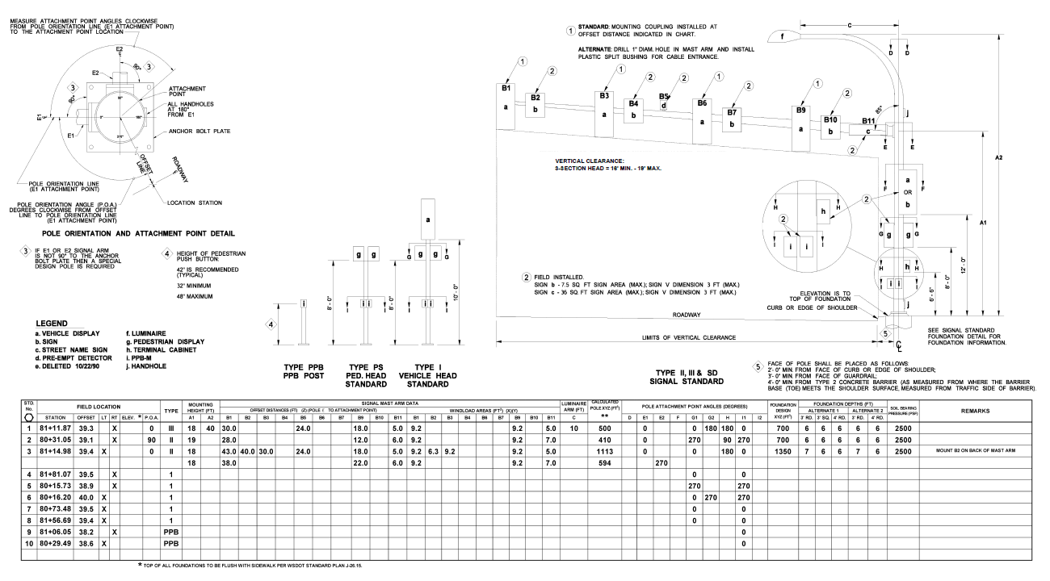
Chapter 6 – Traffic Signalization
WSDOT Type I, II, III, PPB (no new span wires)

Slide 51
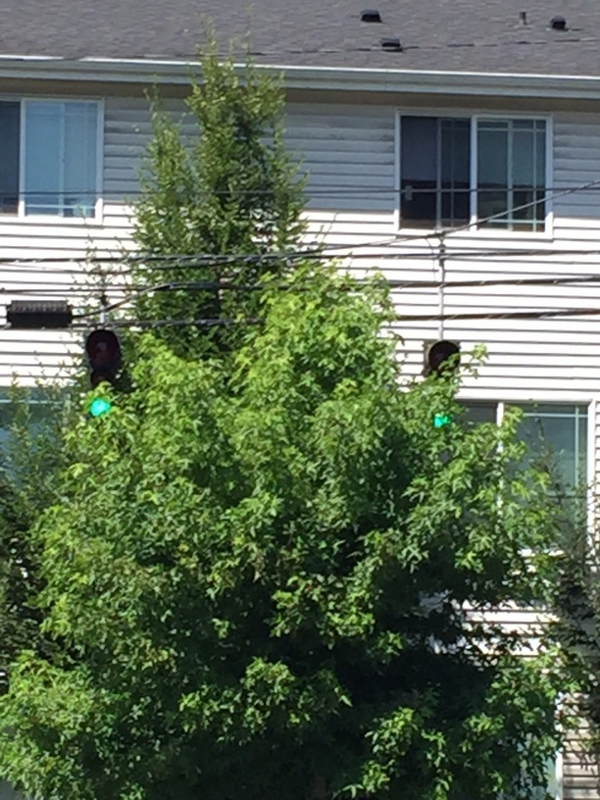
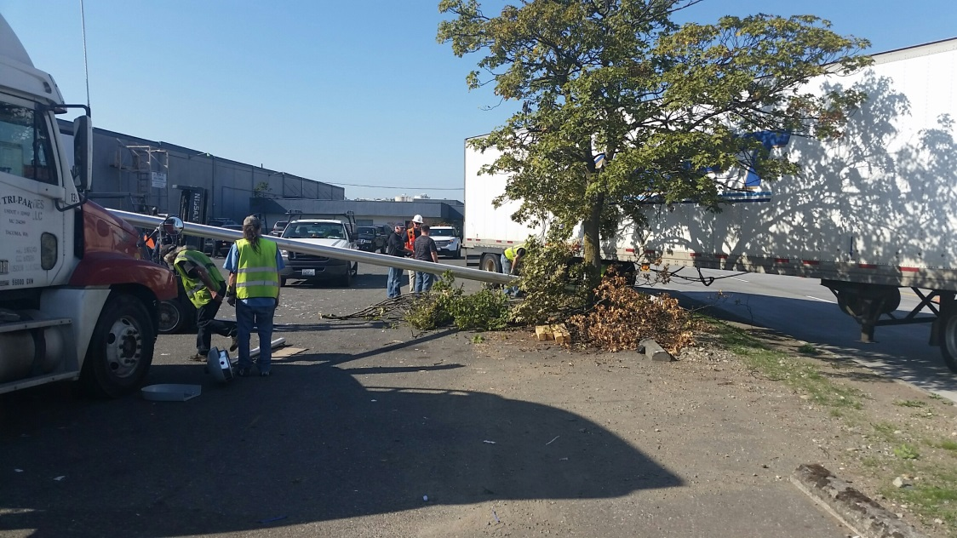
Chapter 6 – Traffic Signalization
Consider equipment placement in relation to other existing and proposed improvements.

Slide 52
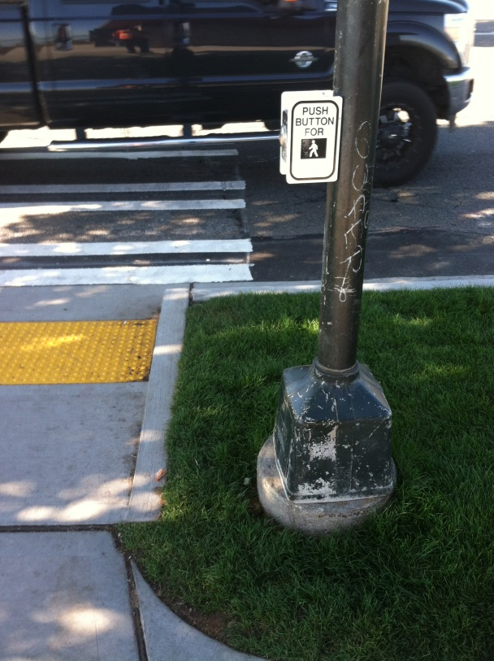
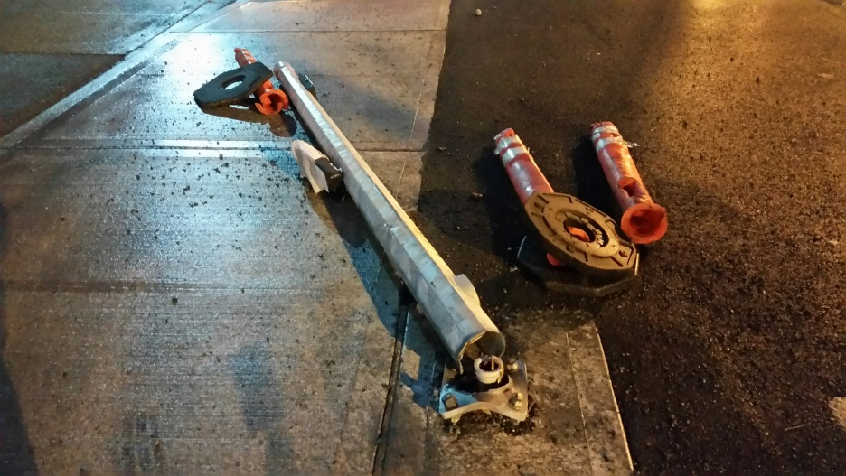
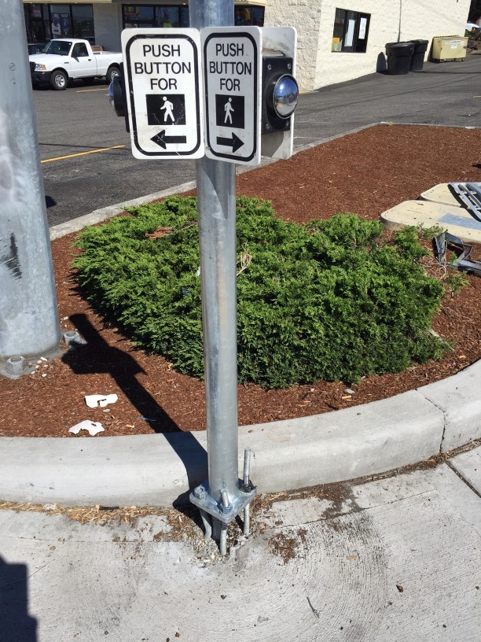
Chapter 6 – Traffic Signalization
Meet ADA and MUTCD, but very carefully.

Slide 53
Chapter 6 – Traffic Signalization
Meet ADA and MUTCD, but very carefully

Slide 54
Chapter 6 – Traffic Signalization
Vehicle Detection
New detection shall be non-intrusive and aerial-mounted.
Thermal video, infrared LED sensors, microwave, & fisheye lens video
Exceptions shall adhere to RCW 47.36.025
MicroRadar® pucks by Sensys Networks Inc.

Slide 55
Chapter 6 – Traffic Signalization
Required Systems
Accessible Pedestrian Signals
2-wire system (Polara Navigator)
Signal Preemption
Opticom™ 700 Series Detectors, Model 760 Card Racks, and Model 764 Multimode Phase Selectors
Signal Controllers
Siemens m60 series ATC

Slide 56
Chapter 6 – Traffic Signalization
Construction Plans/Electrical Design
2-inch PVC (SCH 80 under streets/driveways)
1-inch allowed to pushbutton poles with 1 pushbutton
Provide conduit fill calculations
WSDOT (Types 1 and 2) junction box with locking lid
Type 2 for interconnect
Coordinate with Traffic Engineering and ADA coordinator when junction boxes are located within ramps and PAR.

Slide 57
Chapter 6 – Traffic Signalization
Construction Plans/Electrical Design
Install a separate ground wire in every conduit run.
All signal head wiring shall be 5-conductor.
Do not split 5-conductor for high and low voltage in a single cable; pull separate 2-conductor for pushbutton when sharing a pole with pedestrian head.
5-conductor may be split between two pedestrian heads on a common pole with jumper across the neutral.

Slide 58
Chapter 6 – Traffic Signalization
Miscellaneous
NEMA TS2, Type 2 P cabinets are required.
Contact Traffic Engineering for UPS installations.
New signals shall be interconnected and fiber-ready.
New pedestrian-actuated beacons shall be rectangular rapid flashing beacons (RRFBs).

Slide 59
Questions…

Slide 60
Chapter 7 Channelization and Signing Overview Comparison
2016 Sections/Topics
2004 Sections/Topics
Project Initiation
Documentation of Conditions
Plans Preparation
(including design guidelines)
Construction Requirements
New formal Standard Plans
(in review)
Non-Essential Signs
Process
Plan Format
Design Guidelines
Same topic
Channelization Details
Notes:
“Common Terms” – so everyone is talking the same “language” with respect to channelization/signing designs
“Project Expectations” & “Design Coordination & Guidance” – resulting in better quality designs by staff and consultants alike
“Plans Preparation” – consistent designs which streamlines review time and implementation
“Construction Requirements” – hand-in-hand with proper plans, minimizes re-work, change orders – new set of standard notes for channelization & signing
“Standard Plans” – probably the most beneficial of the changes since it would provide a publicly available set of drawing and details reflective of City expectations for channelization and signing..still undergoing Stds Committee approval process.

Slide 61
Content Summary for Sections with Highlighted Aspects
Project Initiation
Scope of design determination
design elements (references within Manual)
addresses striping/pavement markings allowances (paint vs. thermoplastic use, no substitution of WSDOT Standard Plan without prior approval) AND signs (new standard plan for installation/placement)
coordination of design elements
Documentation of Conditions
Site visit (what to review), inventory of elements (e.g., striping configurations, current lane widths, sign sizes, sheeting, condition)
project extents determination (may extend the limits of the project)
Plans Preparation
General requirements (Ch. 3 referral)
plan sheet content (list of 30 items) including sheet org/display guidance (enough information to comprehend the design without other sheet referrals)
design guidance (included as subsection) referral to standard plans (new, see enclosed) and specific to crosswalk installation/markings (see matrix)
Notes:
Project Initiation, Documentation of Conditions – both not previously addressed in Chapter – new content provides better, more detailed guidance so that resulting plans are comprehensive and complete
Plans Preparation – previously advised only to refer to Chapter 3 (no specifics on particular elements/depiction schemes related to channelization design)

Slide 62
Crosswalk Installation/Marking Guidance
Roadway Traffic | Average Daily Traffic (2-way total) ≤ 9,000 |  |  | Average Daily Traffic (2-way total) > 9,000 to 12,000 |  |  | Average Daily Traffic (2-way total) > 12,000 to 15,000 |  |  | Average Daily Traffic (2-way total) > 15,000
Speed Limit (in MPH) | ≤ 30 | 35 | 40 | ≤ 30 | 35 | 40 | ≤ 30 | 35 | 40 | ≤ 30 | 35 | 40
Total Lanes
Two | C | C | P | C | C | P | C | C | N | C | P | N
Three | C | C | P | C | P | P | P | P | N | P | N | N
Four or more (with raised median*) | C | C | P | C | P | N | P | P | N | N | N | N
Four or more (without raised median) | C | P | N | P | P | N | N | N | N | N | N | N
C = Candidate sites for marked crosswalks (assuming ADA and PROWAG requirements are met).
P = Possible increase in pedestrian crash risk may occur if crosswalks are added without other pedestrian facility enhancements
N = Marked crosswalks alone are insufficient, since pedestrian crash risk may be increased by providing marked crosswalks alone
* The raised median or crossing island must be at least 4 feet wide and 6 feet long to serve adequately as a refuge area for pedestrians, in accordance with the MUTCD and the AASHTO A Policy on Geometric Design of Highways and Streets.
Notes:
These guidelines include intersection and midblock locations with no traffic signals or “STOP” signs on the approach to the crossing. They do not apply to school crossings. A two-way center turn lane is not considered a median for the purposes of these criteria.
Adding crosswalks alone will not make crossings safer, nor will they necessarily result in more vehicles stopping for pedestrians. Whether or not marked crosswalks are installed, it is important to consider implementation of other pedestrian facility enhancements (e.g., raised median, traffic signal, roadway narrowing, enhanced overhead lighting, traffic-calming measures, curb extensions), as needed, to improve the safety of the crossing.
The indications in the table above are general recommendations; good engineering judgment should be used and ADA/PROWAG needs and/or implications should be considered in individual cases for deciding where to propose/install crosswalks.

Slide 63
Content Summary for Sections with Highlighted Aspects
Construction Requirements
Same WSDOT Standard Specifications referrals, but developed/added General Notes for Channelization or Signing (highlights below) as attachment
Contractor to schedule inspection of pavement marking layout at least 3 business days prior to installation of permanent striping
Contractor shall remove all existing pavement markings and striping in conflict with the final striping plan by hydro-blasting or other approved noninvasive method.
Applying additional markings to obscure erroneous markings is not an approved method for obliteration.
Type IV or better sign sheeting; 2-inch posts
Sign formatting/layouts to be submitted to Traffic for approval (if not specified in plans)
Minimization of installing new sign posts, use streetlight poles (as available) and re-use existing sign posts (as appropriate)
Mounting hardware changes and sign relocations (due to visual conflict or safety concern) part of Contractor’s responsibility
Notes:
Construction Requirements – addition of General Notes for Channelization or for Signing
Signing General Notes

Slide 64
Content Summary for Sections with Highlighted Aspects
Non-Essential Signs
Destination/wayfinding signs, cultural interest signs, memorial signs, and other similar signs are supplemental to other signing and shall not be installed where there is insufficient spacing from signing of higher priority.
Costs related to the purchase, installation, and maintenance of these signs will be borne by the party requesting the sign. While no maintenance agreement is typically necessary, the signs will typically only be maintained by the City by request to the Engineering Division of the Public Works Department.
Advertising and private signs are not addressed herein, but instead are controlled by applicable City ordinances and state and federal regulations.
Signs relating to services and businesses are not typically provided in urban areas, and are not permitted. All other wayfinding, guide, and cultural/recreational interest signs shall meet the requirements of this section and the MUTCD.

Slide 65
Questions…

Slide 66
Chapter 8 – Pedestrian Facilities
This is a new chapter that incorporates ROW elements that affect accessibility
The City strives to make the ROW useable for everyone
Includes elements such as sidewalks, curb ramps, accessible pedestrian signals, crosswalks, and maintaining pedestrian access during construction
Notes:
Gail

Slide 67
Chapter 8 - Pedestrian Facilities
ADA Requirements by Project Type:
New construction- full ADA compliance with no excuses
Alterations- full ADA compliance but if infeasible a detailed written justification is required
Maintenance- does not trigger ADA upgrades

Slide 68
Chapter 8 - Pedestrian Facilities
Accessibility Criteria for Pedestrian Circulation Paths and Access Routes
Pedestrian Circulation Paths (PCPs)
Vertical clearances, horizontal encroachments, post-mounted objects
Pedestrian Access Route (PAR)
Clear widths, cross slope and grade, surface, horizontal openings

Slide 69
Chapter 8 - Pedestrian Facilities
Curb Ramps
Types of curb ramps
Accessibility criteria
Design Criteria
Directional curb ramps
Drainage
Design to less than the maximum slope

Slide 70
Chapter 8 - Pedestrian Facilities
Accessible Pedestrian Signals (APS)
Location
Function
On-Street Parking
ADA/disability parking
At-Grade Rail Crossings
Mind the gap

Slide 71
Questions…

Slide 72
Chapter 9 – Tree and Vegetation Management
Chapter applies to all “Regulated Trees” and landscaping in the ROW
Consolidation of TMC, permitting processes and other codified documents
Adoption of the Urban Forest Manual for requirements and recommendations
New vegetation standard plans
Notes:
Mike C

Slide 73
Chapter 9 – Tree and Vegetation Management
Tacoma Municipal Code Primary Applicable Sections (non-exhaustive list)
TMC 9.18 Trees and Shrubs – Trimming and Removal
TMC 9.19 Trees and Shrubs – Planting
TMC 9.20 Trees and Shrubs – View Blockage
TMC 13.11 Critical Areas Preservation
TMC 13.06.502 Landscaping and Buffering Standards
Notes:
TMC 9.18 Trees and Shrubs – Trimming and Removal
This covers the application requirements for tree removals, pruning, and tree protection during construction (1927)
TMC 9.19 Trees and Shrubs – Planting
Covers permitting process, prohibited trees and permitted types of trees
TMC 9.20 Trees and Shrubs – View Blockage
Covers permitting process, criteria for removal
TMC 13.11 Critical Areas Preservation
Covers all vegetation in regulated critical areas
TMC 13.06.502 Landscaping and Buffering Standards
Covers applicability of tree and landscape requirements in applicable zones.
Requires percentages of trees/shrubs to be native when in designated habitat corridors.
Adopts the Urban Forest Manual for all required landscaping

Slide 74
Chapter 9 – Tree and Vegetation Management
Urban Forest Manual (UFM)
Covers requirements for all landscaping on both private property and in the right-of-way where required per the zoning code (TMC 13.06.502).
Information includes:
landscaping requirements | vegetation diversity
setbacks and clearances | soil depth and unpaved areas
tree protection during construction | pre-approved street tree list
Notes:
Mike C

Slide 75
Chapter 9 – Tree and Vegetation Management
Standard plans include:
Tree planting and soil volumes
Tree clearance requirements
Shrubs, groundcovers and planting on slopes
Tree protection during construction
Soil amendments
Notes:
Mike C

Slide 76
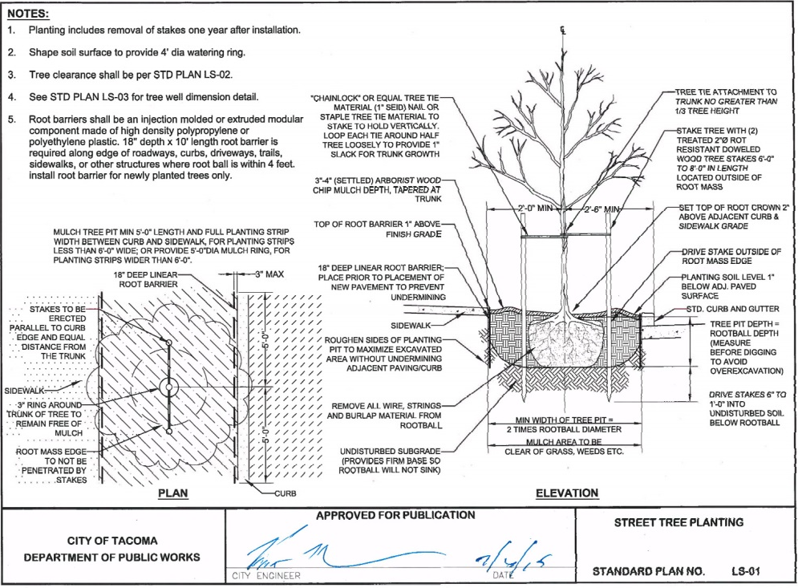
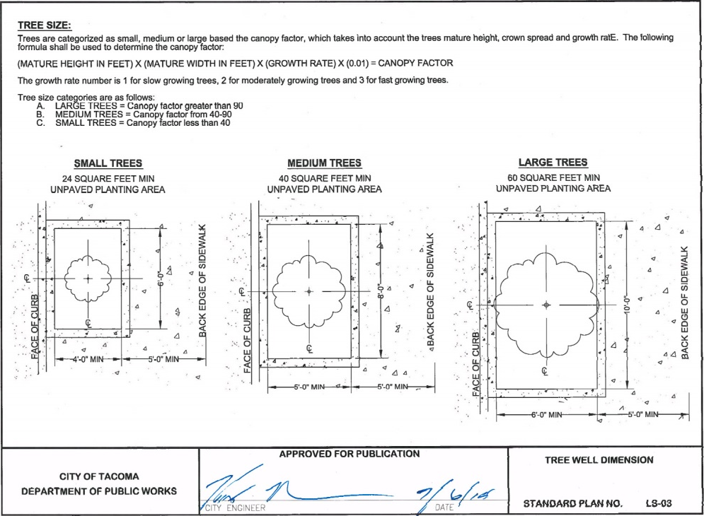
Chapter 9 – Tree and Vegetation Management
Tree Planting Soil Volumes
Notes:
Mike C

Slide 77
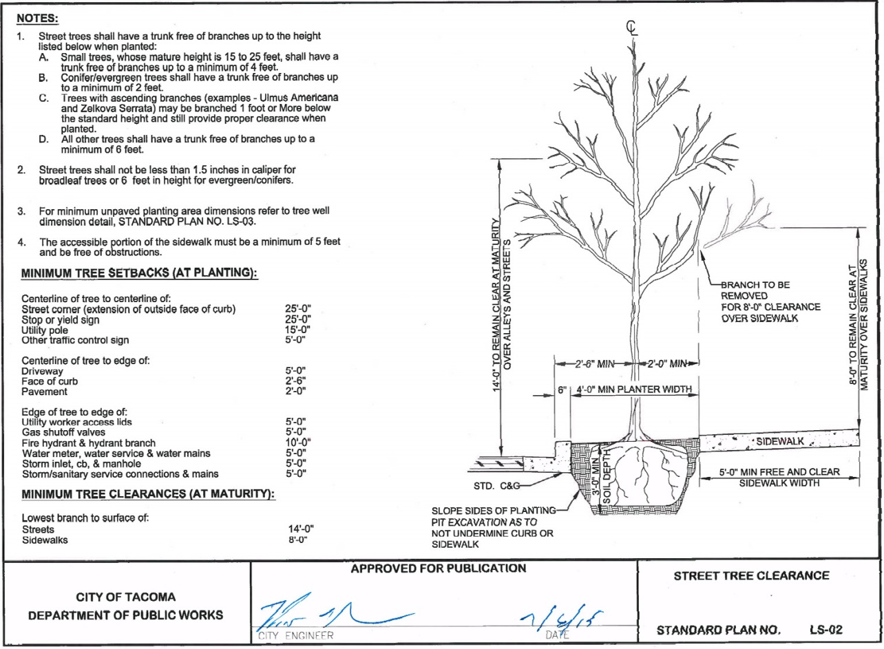
Chapter 9 – Tree and Vegetation Management
Tree Clearances
Notes:
Mike C

Slide 78
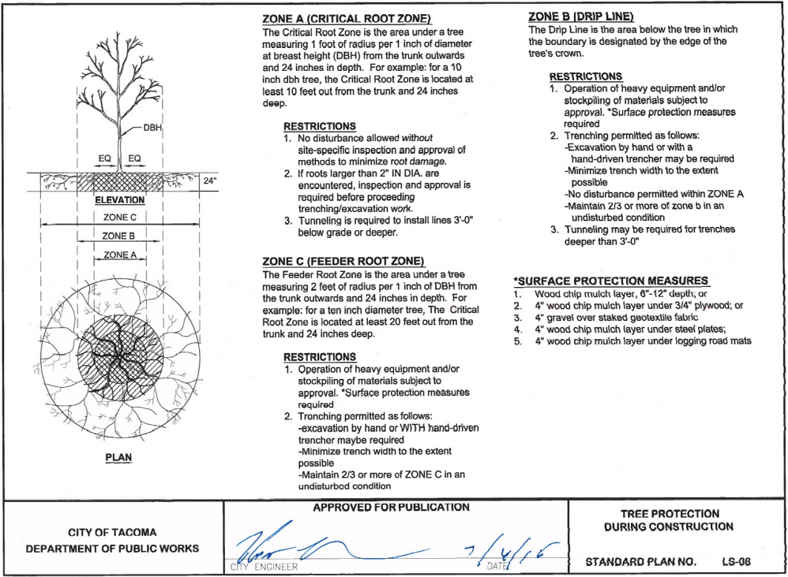
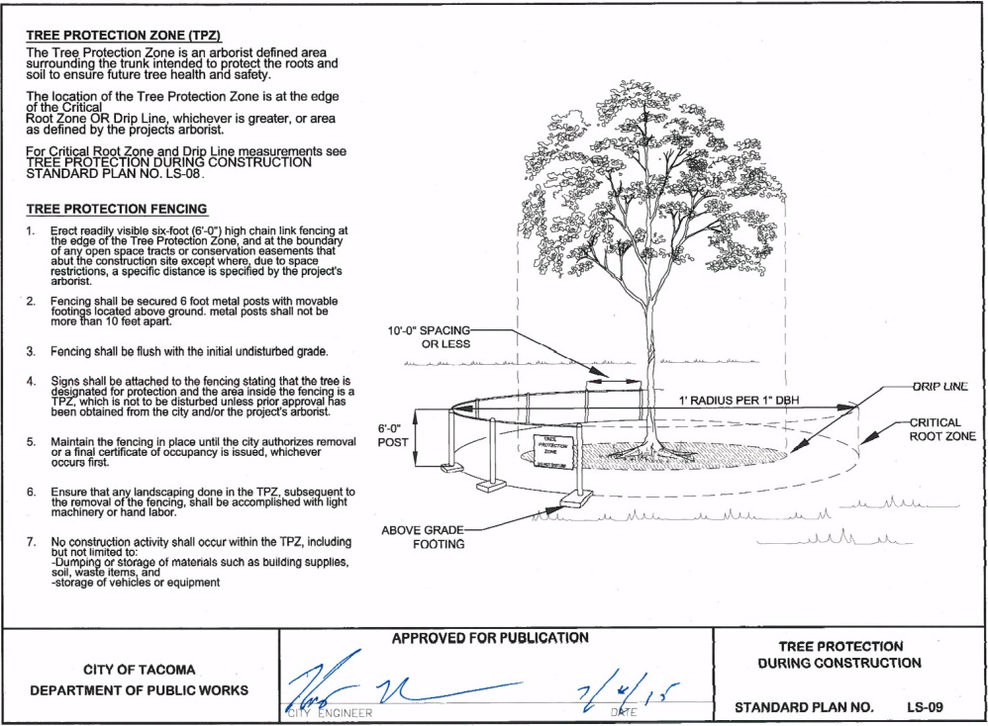
Chapter 9 – Tree and Vegetation Management
Tree Protection Zones and Permitted Activities
Notes:
Mike C

Slide 79
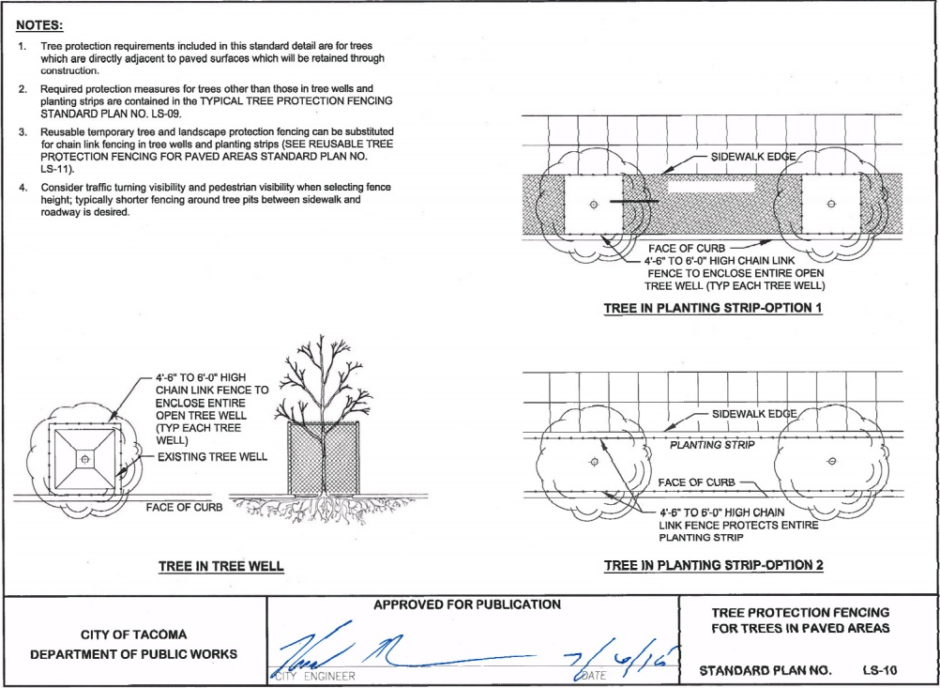
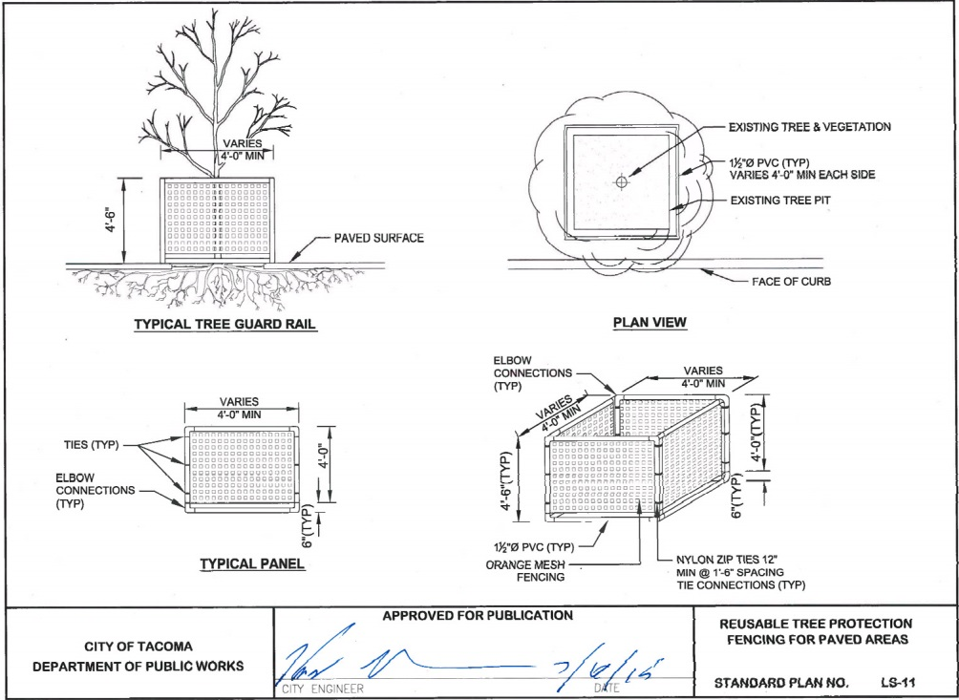
Chapter 9 – Tree and Vegetation Management
Tree Protection Fencing
Notes:
Mike C

Slide 80
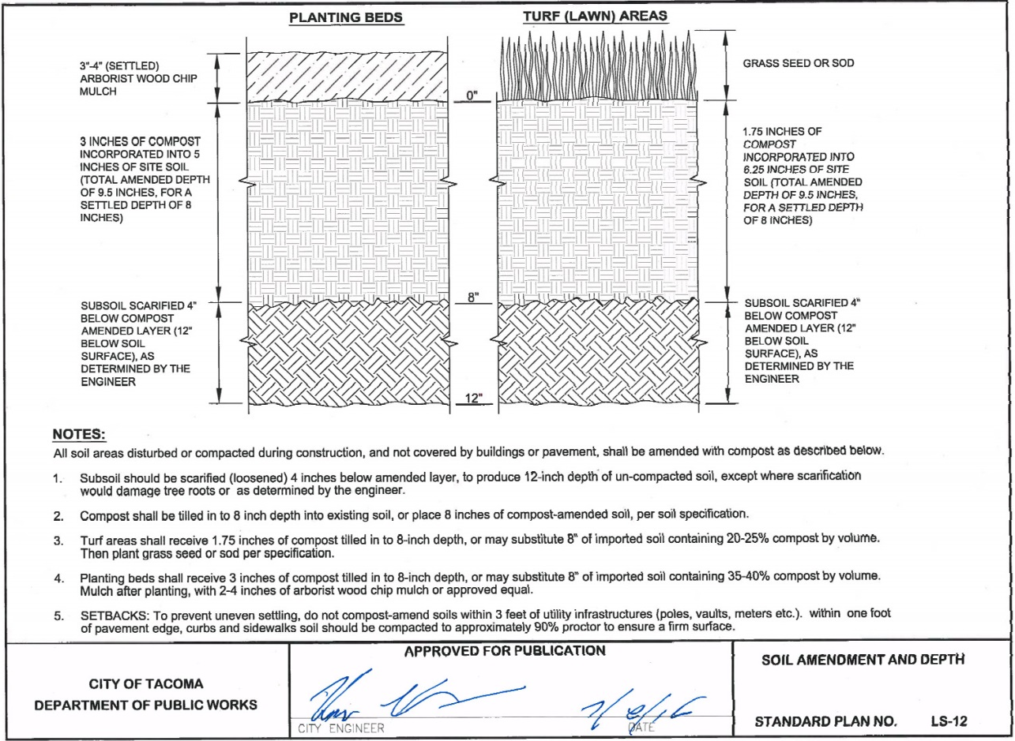
Chapter 9 – Tree and Vegetation Management
Soil Amendments
Notes:
Mike C

Slide 81
Questions…

Slide 82
Chapter 10 – Shared Use Paths
Outlines design requirements for off-street paths
Provides guidelines on width, slope, clearance, signage, buffers, etc. of paths
Reference relevant City guideline documents: Tacoma Waterfront Design Guidelines; Master Mobility Plan; Pedestrian and Bicycle Design Guidelines
Reference to other relevant national standards and design guidance documents: AASHTO; PROWAG; ADA Standards for Accessible Design; etc.
Notes:
Raymond

Slide 83
Questions…

Slide 84
Chapter 11 – Stormwater and Wastewater Sewer Design
Terminology – Wastewater replaces Sanitary
All side sewer information, including private pump systems, is replaced with references to the Side Sewer and Sanitary Sewer Availability Manual
Some stormwater info removed and referenced to SWMM
Section 1 – Existing System Drawings, available on www.govME.org
Section 2 – Wastewater Assessment and Connection Charges – must be paid prior to connection, type depends on property

Slide 85
Chapter 11 – Stormwater and Wastewater Sewer Design
Section 3 Sizing:
Wastewater: Ecology’s Criteria for Sewage Works Design (Orange Book)
Side Sewer and Sanitary Sewer Availability Manual outlines capacity analysis for wastewater sewer
Notes:
Mieke

Slide 86
Chapter 11 – Stormwater and Wastewater Sewer Design
Stormwater:
Design criteria for stormwater conveyance system sizing, stormwater facility sizing, and compliance with MRs is contained in Stormwater Management Manual (SWMM).
A quantitative downstream analysis will be required before connections to the stormwater system will be allowed for certain projects that are likely to create an impact to the downstream system
See table next slide and SWMM for analysis requirements
Notes:
Mieke

Slide 87
Chapter 11 – Stormwater and Wastewater Sewer Design
Increase in Contributing Surface Area | Pipe Size | Required Analysis
<5,000 SF | Any Size | None
≥5,000 SF & <10,000 SF | ≥12” | None
≥5,000 SF & <10,000 SF | <12” | Single Segment Capacity Analysis & Inlet and Grate Capacity Analysis (if applicable)
≥10,000 SF | ≥12” | Single Segment Capacity Analysis & Inlet and Grate Capacity Analysis
≥10,000 SF | <12” | Full Backwater Analysis & Inlet and Grate Capacity Analysis
Any Size | Connecting to trunk main | None
Notes:
Mieke

Slide 88
Chapter 11 – Stormwater and Wastewater Sewer Design
Section 4 Gravity Pipe Design Criteria
Size, slope, material, depth, cover, alignment, couplings, anchors, construction requirements

Slide 89
Chapter 11 – Stormwater and Wastewater Sewer Design
Section 4 Changes:
Stormwater:
CPEP will not be allowed for publically maintained stormwater pipes
Stormwater pipe materials now include vitrified clay pipe and PVC lined concrete pipe
Wastewater:
Wastewater pipe materials now include vitrified clay pipe, water pressure rated pipe, HDPE pipe, and PVC lined concrete pipe
Both:
The use of rigid couplers to connect non-bell and spigot pipe joints has been added
Notes:
Mieke

Slide 90
Chapter 11 – Stormwater and Wastewater Sewer Design
Section 5 Manhole Design Criteria
Location, type, covers, connections
Section 6 Catch Basin Design Criteria
Connections, locations, type, size, inlet

Slide 91
Chapter 11 – Stormwater and Wastewater Sewer Design
Section 7 Low Pressure Grinder Pump Wastewater Systems:
Design criteria for low pressure grinder pump sewer systems has been included for areas where gravity sewers are not feasible
Design per Ecology’s Orange Book
Notes:
Kari

Slide 92
Chapter 11 – Stormwater and Wastewater Sewer Design
Section 8 – Open Channel Design Criteria – refer to SWMM
Section 9 – Separation Requirements
Manholes and Structures - 10 feet
WW and SW - 5 feet horizontal
WW and Water - 10 feet horizontal & 18 inches vertical
SW and Water – 5 feet horizontal

Slide 93
Chapter 11 – Stormwater and Wastewater Sewer Design
Section 10 – Access and Easements
Min. 15 foot Access Easement required outside of right of way or easements
Wastewater Easement Width
Minimum width 20 feet, based on pipe invert depth, See Table 11-4
Stormwater Easement Width
Minimum width for pipe easements 20 feet based on pipe invert depth, channels based on channel width, See Table 11-5.

Slide 94
Questions…

Slide 95
Chapter 12– Water Plans
Water main design shall be completed by Tacoma Water
Design process is initiated by the Developer calling the Tacoma Water at (253) 502-8247
Water main within the right of way shall be laid to the permanent grade and alignment of the street, and shall require the approval of the City Engineer
Notes:
Ryan

Slide 96
Questions…

Slide 97
Chapter 13 – Construction Related Permits and Easements
Reorganized chapter to incorporate relevant information into other chapters
Incorporated new and updated policies and procedures
Notes:
Mieke
Expanded up Erosion Control Section
Adding Soil Management Plan reference
Moved permit and traffic/road sections to other chapters

Slide 98
Chapter 13 – Construction Related Permits and Easements
Temporary construction easement required for adjacent property impacted by project prior to permit approval and construction.
Some projects require ROW dedication or acquisition to construct improvements.
Private or public easements may be required.
Private easement – between two or more private properties.
Public easement – between private and public
Notes:
Mieke
Expanded up Erosion Control Section
Adding Soil Management Plan reference
Moved permit and traffic/road sections to other chapters

Slide 99
Chapter 13 – Construction Related Permits and Easements
Traffic control required for all work that may affect traffic.
Govme.org for Traffic Control Handbook – requirements and guidance for traffic control plans.
May include street closures, lane closures, sidewalk closures.
Environmental Checklist
Utility pipe greater than 12” in diameter
Fill or excavation in excess of 500 cubic yards
Erosion Control
Required for all projects. Certain projects may require SWPPP or NPDES Construction Permit
Notes:
Mieke
Expanded up Erosion Control Section
Adding Soil Management Plan reference
Moved permit and traffic/road sections to other chapters

Slide 100
Questions…

Slide 101
Side Sewer and Sanitary Sewer Availability Manual
Updating the 2011 version
Effective January 7, 2016
General changes for clarity and terminology. For example:
Public Works to Environmental Services
Available at www.cityoftacoma.org/sidesewer
Notes:
Kari

Slide 102
Side Sewer and Sanitary Sewer Availability Manual
Vitrified clay pipe allowed for side sewers
Connections to public sanitary sewer
Removal of host pipe when connecting to a CIPP lined public sanitary sewer
Connection at manhole for all side sewers 8-inch and greater
Notes:
Kari

Slide 103
Side Sewer and Sanitary Sewer Availability Manual
TV inspection requirements for pipe bursting and CIPP lining
Allows for on-site pre-inspection video with 24 hour advance notice or submittal for review
Post inspection video shall be performed with the inspector present with 24 hour advance notice
Notes:
Kari

Slide 104
Side Sewer and Sanitary Sewer Availability Manual
Shared Side Sewer Lines
Separation of side sewers required when repairs are necessary on the shared portion
Exceptions may be granted on a case-by-case basis
New chapter for grease interceptor requirements
Notes:
Kari

Slide 105
Questions…

Slide 106
City of Tacoma Right-of-Way Design Manual
Effective January 7, 2016
Available online at www.cityoftacoma.org/designmanual
CD with Design Manual available
Thank You for attending!

